Slide 1
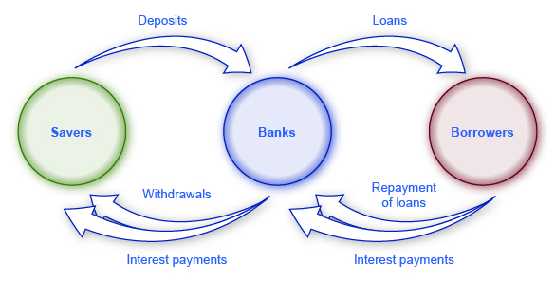
Simple banking system group 2
Your initial balance is 1000$
MENU
1.Deposit money
2.Withdrawing money
3.Check my balance
4.Exit

Slide 2
REQUIREMENT ANALYSIS
1. The user should be able to enter two numbers.
2. The user should be able to choose an operation (addition, subtraction, or multiplication).
3. The calculator should display the result.
4. The program should keep running until the user chooses to exit.

Slide 3
SYSTEM DESIGN
1. The welcome message to the user when the program starts
2. Full possible transaction list for user interaction
3. A loop to allow user do all the transactions they want to do, so the program runs until the user wants to quit

Slide 4
IMPLEMENTATION
1. A banking program code with different transactions (Deposit, Withdrawal, Check Balance)

Slide 5

Step 4. testing
Identfy and fix bugs & defects before
deployment.
Perform functional testing(Does it work?)

Slide 6
Step 5. Deployment
Step 6. Maintenance
Deliver the final software to the client.
Provide training and monitor system performance
Fix bugs reported by users.
Release updates & security patches.

